Slide 2
Expense reporting backlog
Improve architecture, maintainability, and quality
Adopt a services architecture
Improve accessibility, scalability, and operations
Move to the cloud
Update the user experience
Build a more modern-looking user experience
Expand device support
Companion apps for Windows Store and Windows Phone

Slide 3
Agenda
Windows 8 and Windows Store apps
Windows Phone apps
Building for both

Slide 4
Windows Store Apps

Slide 5
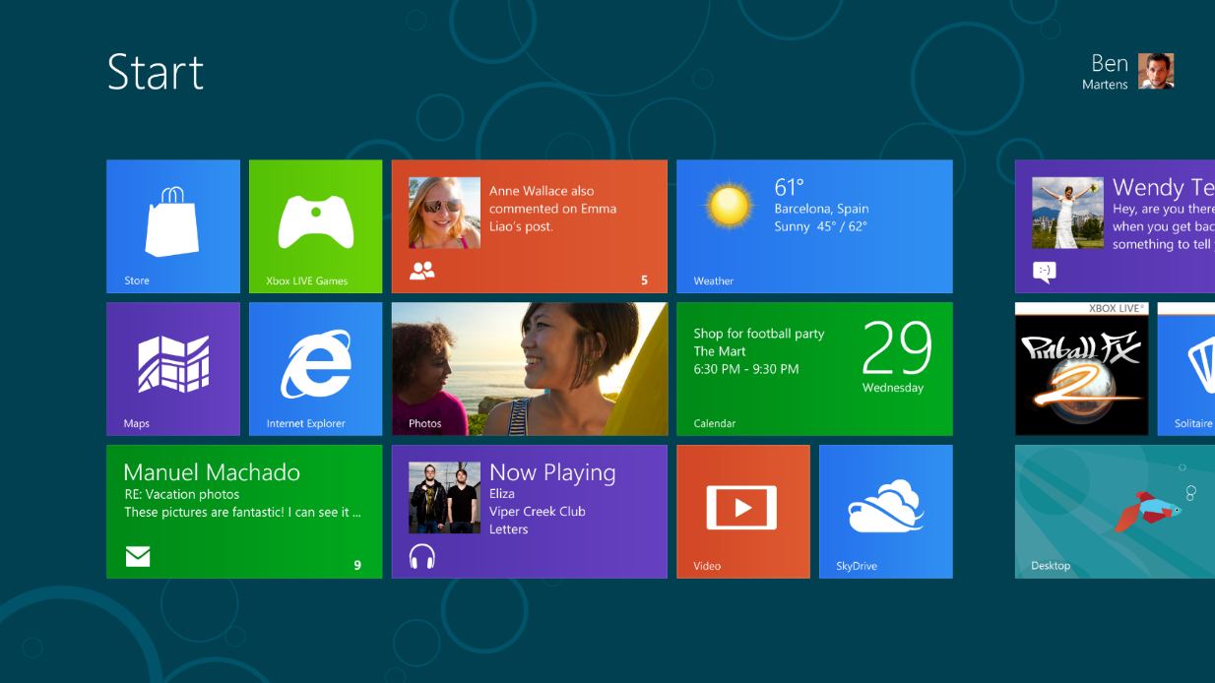

Windows reimagined
New fast and fluid Start screen
Touch,
mouse, keyboard
Everything great about Windows 7 we made even better

Slide 6
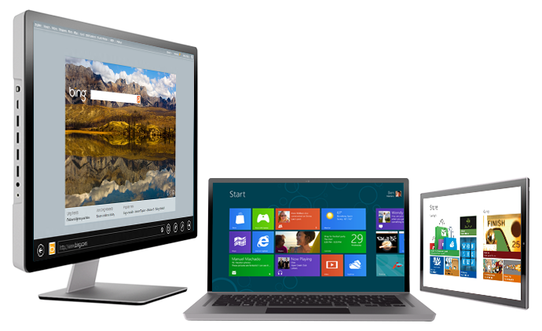
Great experience across all hardware
Tablets to laptops to all-in-ones
Touch,
mouse, keyboard
Highest power to the most efficient chipset

Slide 7
Windows 8 Experience
Fast and fluid user experience
Responsive, alive, beautiful
Immersive and full-screen
Focuses attention on your apps
Touch-first with full keyboard and mouse
Enables your choice of interaction
Web of apps working together
Apps are connected to each other and the cloud
Experience for all PC devices and architectures
No compromise across new form factors, desktops and laptops

Slide 8
Windows 8 Platform
Windows Store Apps
Desktop Apps
View
XAML
HTML / CSS
HTML
JavaScript
Model Controller
C
C++
C#
VB
JavaScript
(Chakra)
C
C++
C#
VB
WinRT APIs
System Services
Communication
& Data
Graphics & Media
Devices & Printing
Application Model
Internet Explorer
Win32
.NET / SL
Core
Windows Core OS Services

Slide 9
Windows Runtime APIs
User Interface
HTML5/CSS
XAML
DirectX
Controls
Data Binding
SVG
Tiles
Input
Accessibility
Printing
Devices
Communications & Data
Geolocation
Portable
Sensors
NFC
Contracts
Local & Cloud Storage
Web
Media
Notifications
Streams
Playback
Capture
PlayTo
Visual Effects
Memory Management
XML
Networking
SMS
Fundamentals
Application Services
Threading/Timers
Memory Management
Authentication
Cryptography
Globalization

Slide 10
Language projections
Windows
Runtime
Object
(or Component)
Written
in C++, C#, VB
C++ App
Projection
Projection
C#/VB App
CLR
Chakra
HTML App
Projection
Windows Metadata

Slide 11
The C# code you have to write today…
[DllImport("avicap32.dll", EntryPoint="capCreateCaptureWindow")] static extern int capCreateCaptureWindow( string lpszWindowName, int dwStyle, int X, int Y, int nWidth, int nHeight, int hwndParent, int nID); [DllImport("avicap32.dll")] static extern bool capGetDriverDescription( int wDriverIndex, [MarshalAs(UnmanagedType.LPTStr)] ref string lpszName, int cbName, [MarshalAs(UnmanagedType.LPTStr)] ref string lpszVer, int cbVer); // more and more of the same

Slide 12
The C# code you get to write on Windows 8
using Windows.Media.Capture; var ui = new CameraCaptureUI(); ui.PhotoSettings.CroppedAspectRatio = new Size(4, 3); var file = await ui.CaptureFileAsync(CameraCaptureUIMode.Photo); if (file != null) { var bitmap = new BitmapImage() ;
bitmap.SetSource(await file.OpenAsync(FileAccessMode.Read));
Photo.Source = bitmap; }

Slide 13
Flexibility of the Windows experience
Maximum reach to your users across platforms
Native apps
Build for new, mobile scenarios
Leverage search, share and new capabilities
Websites
Broad reach across OSes
Desktop apps
Keep software investments already made

Slide 14
Demo
Build a Windows Store App
Name

Slide 15
Windows Phone Apps

Slide 16
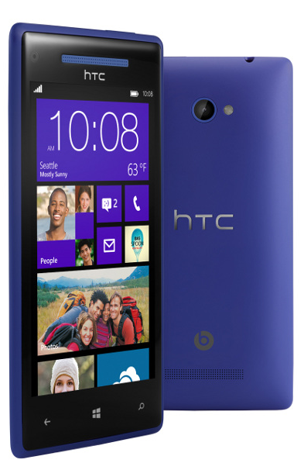
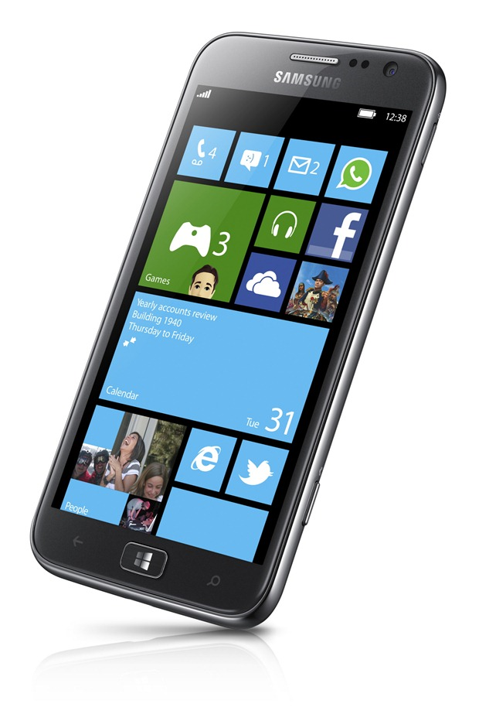
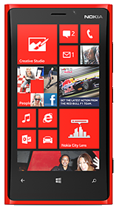
Windows Phone 8 Hardware
Beautiful new hardware from Nokia, HTC, Samsung and more…

Slide 17
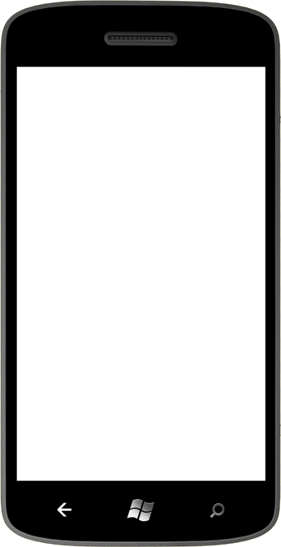
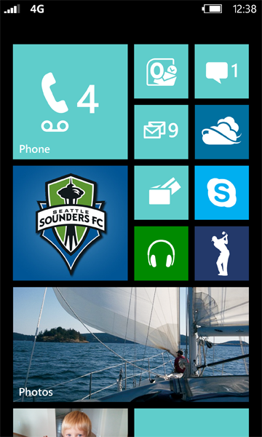


Modern Smartphone Platform
New multicore chipset
New graphics processor
Increased RAM: 1GB or 512MB
More Screen resolutions
Removable, encryptable storage
NFC

Slide 18
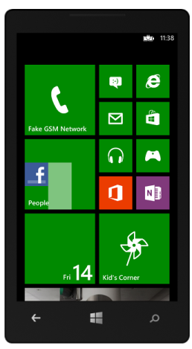
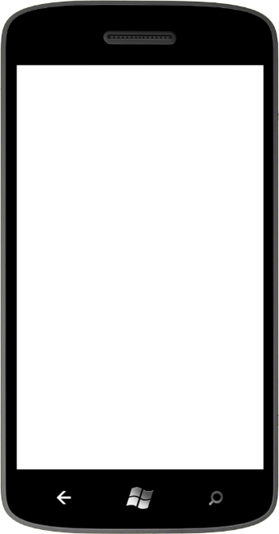
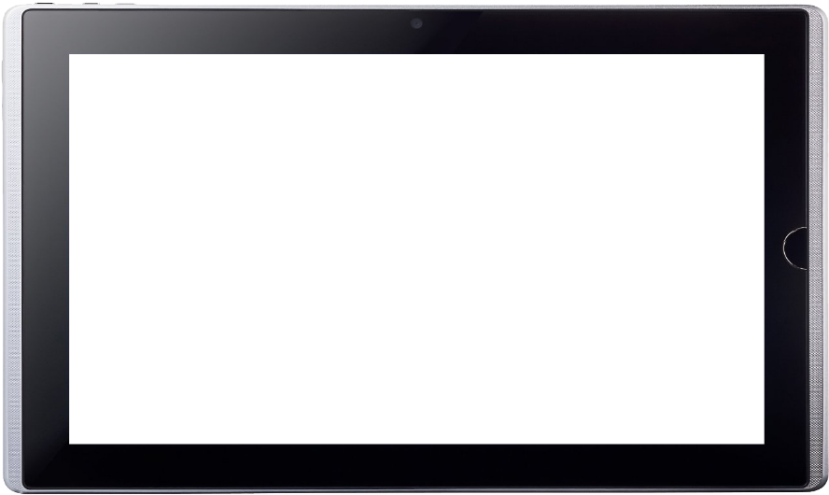
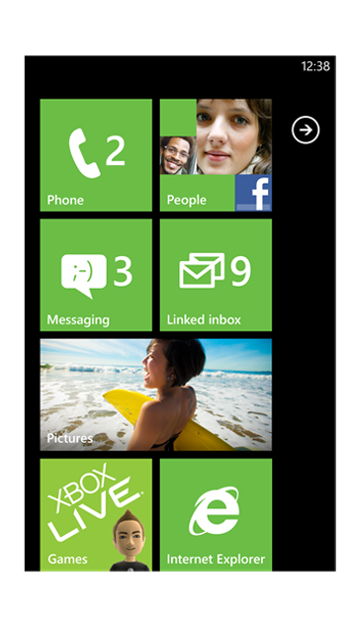
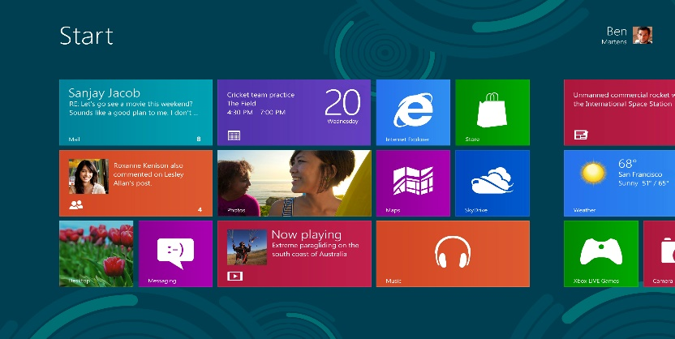
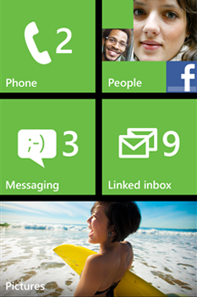
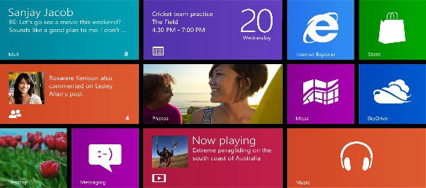
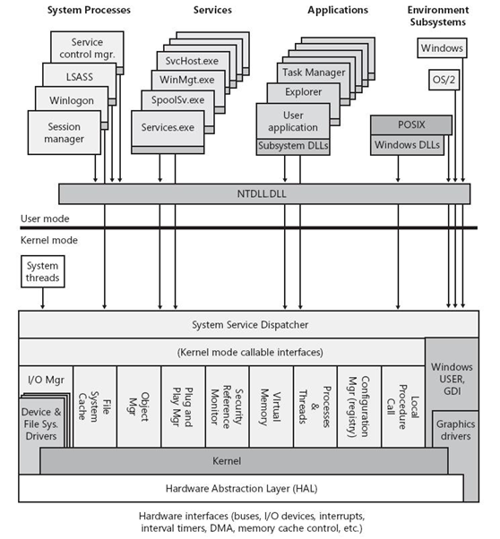

Shared Windows Core
Windows 8 and Windows Phone 8 share many components at the operating system level

Slide 19
Shared Windows Core
Shared Core means
OS components such as the kernel, networking, graphics support, file system and multimedia are the same on both Windows 8 and Windows Phone 8
Hardware manufacturers work with the same driver model on both platforms
Windows Phone gets the support for multi-core and other hardware features that Windows has had for years
These solid, common foundations makes it easier to extend the Windows Phone platform into the future
It doesn’t mean
Windows 8 and Windows Phone 8 developers work to exactly the same APIs
(though you will see more commonality as new features are introduced to both platforms in the future)

Slide 20
Windows Phone 8 Programming APIs
Managed app dev using the WP7.1, WP8.0 .NET and WinPRT APIs
Native app dev using WinPRT and Win32
Games dev using the WP7.1 XNA framework
Games dev using Direct3D or DirectX
WP8.0 Games DirectX/Direct 3D & C++
WP8.0 XAML & C#/VB with Direct3D Graphics
+ C++
WP8.0 XAML & C#/VB
+ C++
.NET API for Windows Phone
Windows Phone Runtime
Win32 & COM
Managed
Managed & Native
Native

Slide 21
Windows Phone Runtime API
.NET API for Windows Phone
Windows Phone Runtime
Win32 & COM
Managed
Managed & Native
Native
Windows Phone Runtime is a subset of the full WinRT, plus some phone-specific additions
Windows (Phone) Runtime is implemented in C++ and projected into C#, VB.NET, and C++
HTML5/JavaScript projection not available on Windows Phone 8
Phone-specific additions to Windows Phone Runtime include
Speech synthesis and recognition
Windows.Phone.Networking.Voip
Windows.Phone.PersonalInformation
LockScreen and LockScreenManager
More…
Full WinRT (around 11,000 members)
Subset adopted for Windows Phone Runtime (around 2,800 members)
New for Windows Phone Runtime (around 600 members)

Slide 22
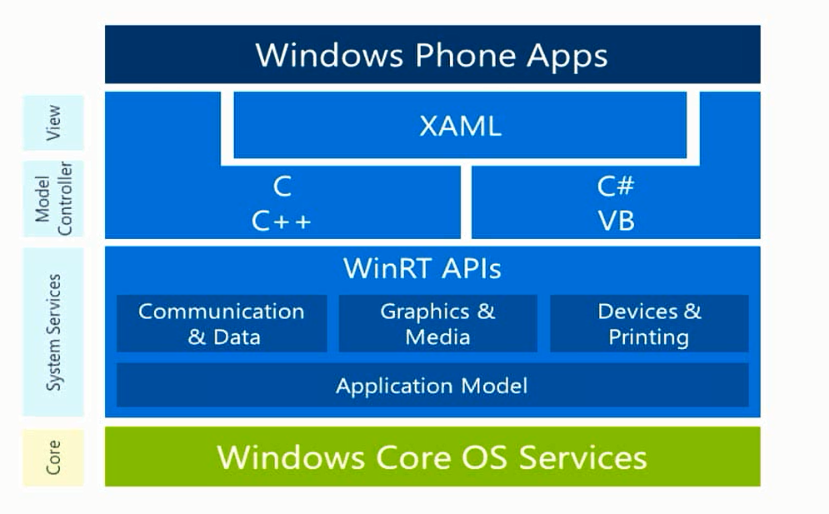
Windows Phone Apps

Slide 23
Demo
Build a Windows Phone App
Name

Slide 24
Building For Both

Slide 25
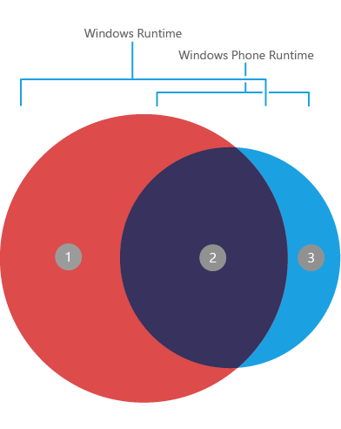
Shared Platform
Windows Runtime
Windows Phone Runtime
Networking
Proximity
In-App Purchase
Sensors
Location
File System
Core app model
Threading

Slide 26
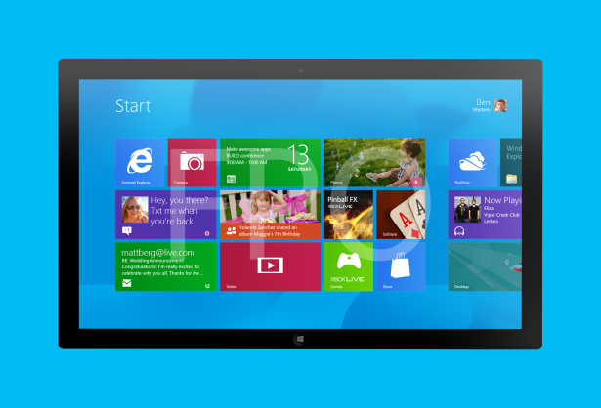
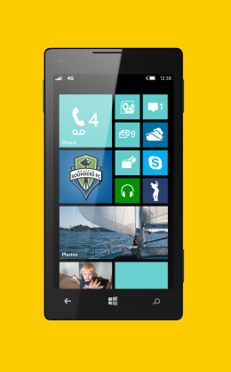
Form Factors
Windows 8
1024x768+
Landscape, Portrait, Snapped, Filled
10 inch screens+
Windows Phone 8
800x480, 1280x720, 1280x768
Portrait, Landscape
<5 inch screen most common

Slide 27
User experience considerations Design a native UX for each platform!
Windows 8
One or two-handed touch, mouse
No guarantee of any specific hardware, must check at runtime
Rows and columns of content can work well
Scroll horizontally for more content
Significant room on the app bar
On-screen back button
Semantic zoom
Windows Phone 8
One-handed touch most common
Guaranteed hardware, such as camera and accelerometer
Avoid multiple columns of content
Scroll vertically for more content
Very limited room on the app bar
Hardware back button
No semantic zoom

Slide 28
XAML
Avoid reusing XAML across Windows Store and Windows Phone apps
Major differences in the platforms make this difficult anyway:
User experience
Screen space
Page layout / orientation
XAML namespaces
XAML controls

Slide 29
Demo
Portable Class Libraries
Name

Slide 30
Demo
Expenses App
Name

Slide 31
Resources
Windows 8 Camp Training Kit
http://www.microsoft.com/en-us/download/details.aspx?id=29854
Build your first Windows Store app
http://channel9.msdn.com/Series/Build-your-first-Windows-Store-app
Windows Store apps for Absolute Beginners with C#
http://channel9.msdn.com/Series/Windows-Store-apps-for-Absolute-Beginners-with-C-
Windows Store apps for Absolute Beginners with JavaScript
http://channel9.msdn.com/Series/Windows-Store-apps-for-Absolute-Beginners-with-JavaScript

Slide 32
Resources
Windows Phone 8 Training Kit
http://www.microsoft.com/en-us/download/details.aspx?id=38782
Windows Phone 8 Development for Absolute Beginners
http://channel9.msdn.com/Series/Windows-Phone-8-Development-for-Absolute-Beginners
Building Apps for Windows Phone 8 Jump Start
http://channel9.msdn.com/Series/Building-Apps-for-Windows-Phone-8-Jump-Start

Slide 33
Resources
Building Apps for Both Windows 8 and Windows Phone 8 Jump Start
http://channel9.msdn.com/Series/Building-Apps-for-Both-Windows-8-and-Windows-Phone-8-Jump-Start

Slide 35

© 2013 Microsoft Corporation. All rights reserved. Microsoft, Windows, and other product names are or may be registered trademarks and/or trademarks in the U.S. and/or other countries.
The information herein is for informational purposes only and represents the current view of Microsoft Corporation as of the date of this presentation. Because Microsoft must respond to changing market conditions, it should not be interpreted to be a commitment on the part of Microsoft, and Microsoft cannot guarantee the accuracy of any information provided after the date of this presentation.
MICROSOFT MAKES NO WARRANTIES, EXPRESS, IMPLIED OR STATUTORY, AS TO THE INFORMATION IN THIS PRESENTATION.

